Slide 1
Real-time Localization, planning, and avoidance
Anish Singhani

Slide 2
Problem Statement
The goal of this project is to create a complete navigation and obstacle avoidance stack that runs on the Hamster robot.
The final result of this project is a system which can track the Hamster’s position, detect obstacles, generate a path, and follow the path to guide the Hamster to travel from it’s starting location to it’s destination (which is selected by the user).
The entire system is very easy to visualize and debug, as almost all steps of the process are shown in a GUI rendered to the user’s screen

Slide 3
Solution Overview
This includes several different components:
Robot localization
Obstacle detection
Configuration space
Roadmap creation
Path generation
Path smoothing
Path following
Automatic replanning
Rendering / UI

Slide 4
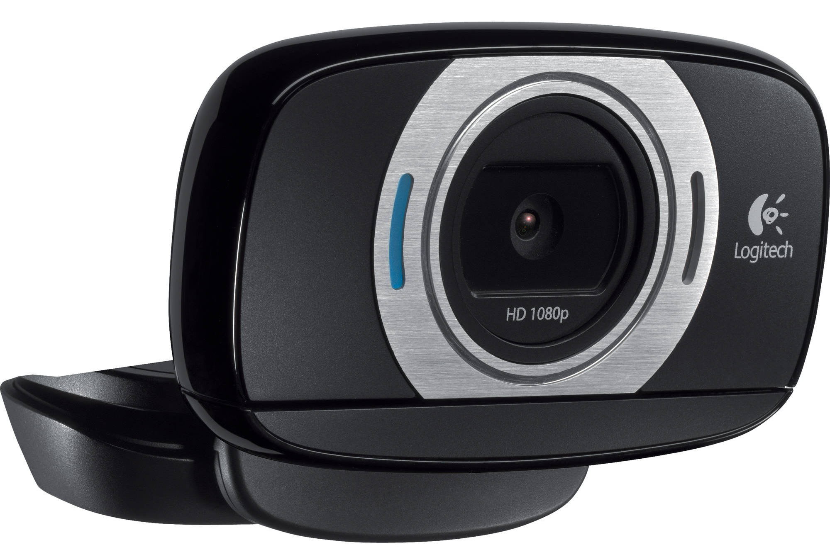
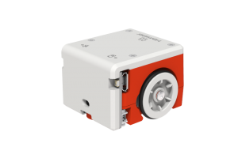
Sensors and Actuators Used
The main sensor used in this project was a single USB camera (the specific camera was a 1080p 30fps Logitech C615)
The reason for this is because a camera can provide a large amount of data while being cost-effective (it is even used frequently for real-world uses like self-driving cars)
This camera was used to detect the position of the robot and position/size of the obstacles.
The controller controlled the left and right wheel speeds (relative to voltage), which allowed it to consistently control the curvature of the robot’s movement

Slide 5
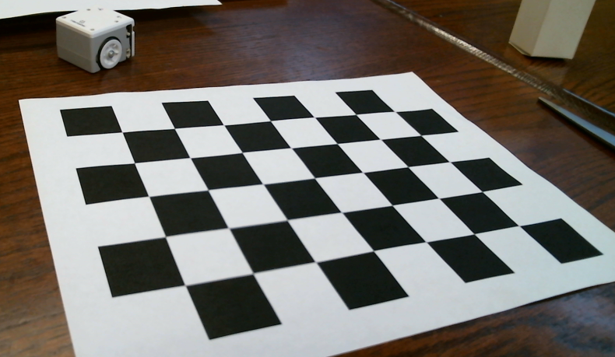
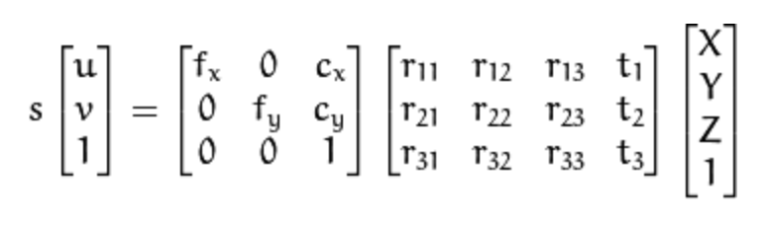
How the Camera Sees the World (Pinhole Model)
Although our world is three dimensional, a camera only sees a single perspective of the world, and outputs a 2D image.
Reliable robot control requires measurements in real-world units, not camera pixels
The camera is calibrated by taking many pictures of a known pattern (often black-and-white grid pattern) and using these to calculate focal length, image center, and distortion coefficients
These values (and the following equation) can then be used to undistort the image and map points from image to world space

Slide 6
Implementation Details

Slide 7





Robot Localization
Two ways of robot localization (position/orientation tracking):
Inside-out (or odometry-based): Encoders, gyroscopes, landmarks, the environment, etc. (all sensors on robot)
Outside-in (global localization): Requires external sensor to track the robot’s position but has no accumulation of drift.
Due to the limited sensors on the Hamster (no encoders, no camera, etc.), this project uses outside-in localization with a single camera (mounted directly above the Hamster and looking down).
Tracking done using ArUco-style unique markers

Slide 8
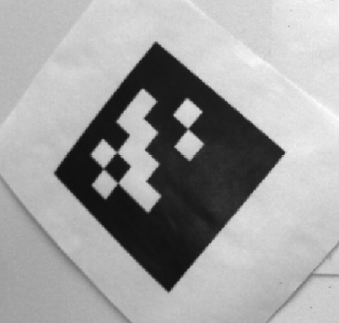
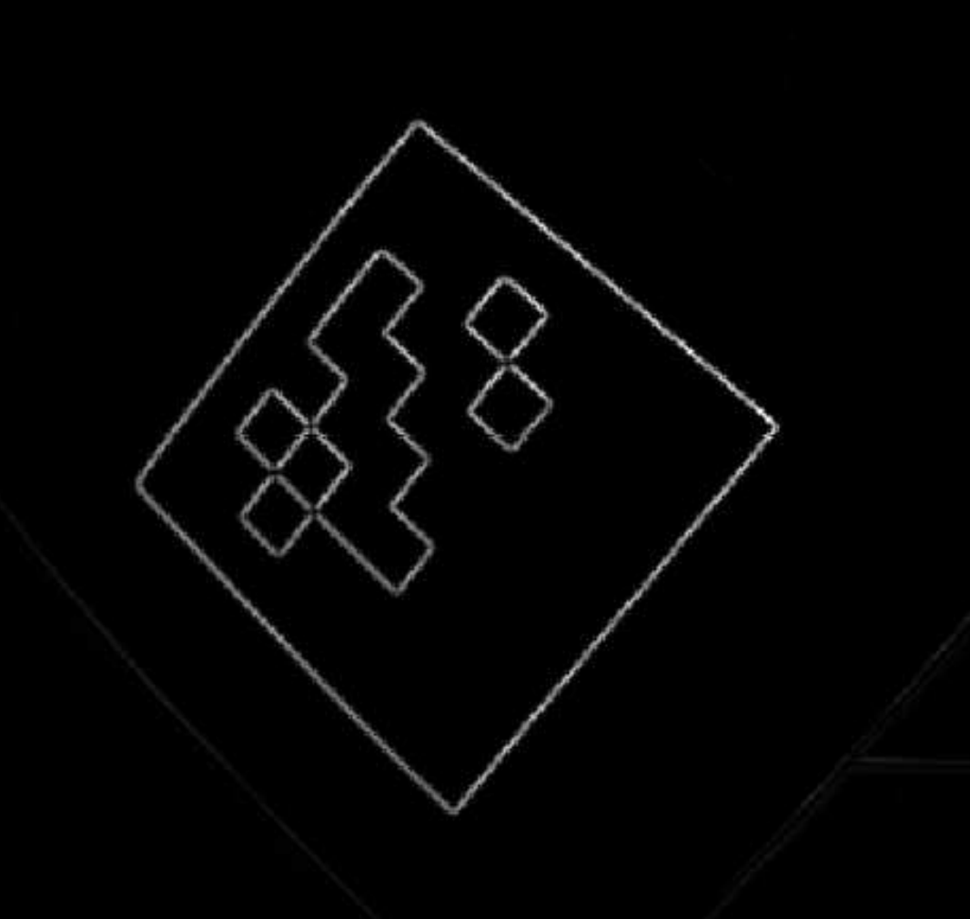
Robot Localization
Marker detection process includes several steps:
Adaptive thresholding (converting image from RGB colors to black-and-white)
Contour detection (contours are the “edges” in an image)
Contour filtering (distance between contours and contour size/shape)
Position and orientation calculation (pinhole camera model and contour points)
Marker identification (check each potential grid location for black or white – encoded in binary)

Slide 9
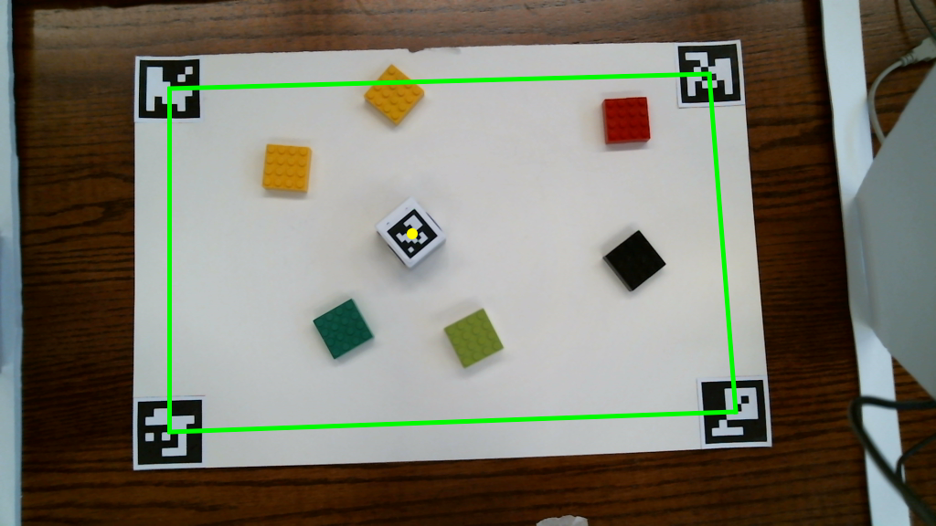
Robot Localization
The workspace for the robot has one marker on each corner
Perspective transform to convert pixel coordinates to physical position

Slide 10
Obstacle Detection (Computer Vision)
Obstacles are detected based on their size, shape, and contrast from the background color.
This is done with a 7 step pipeline which uses the image to compute a 4-point rectangle representing each obstacle
Points accurately represent the obstacle, unlike a bounding box which may have a lot of margin

Slide 11
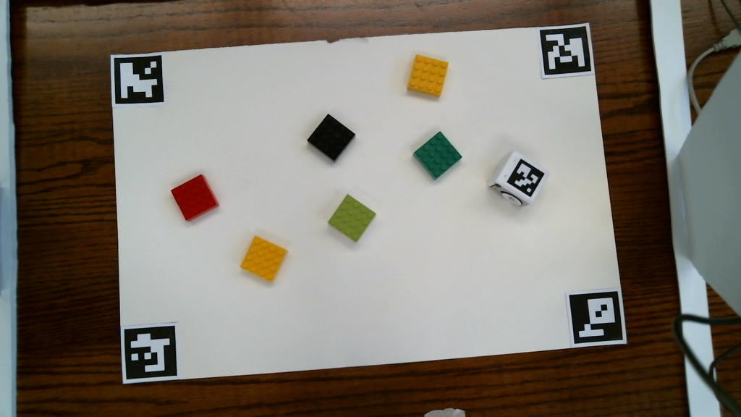
Obstacle Detection (Computer Vision)
Source Image

Slide 12
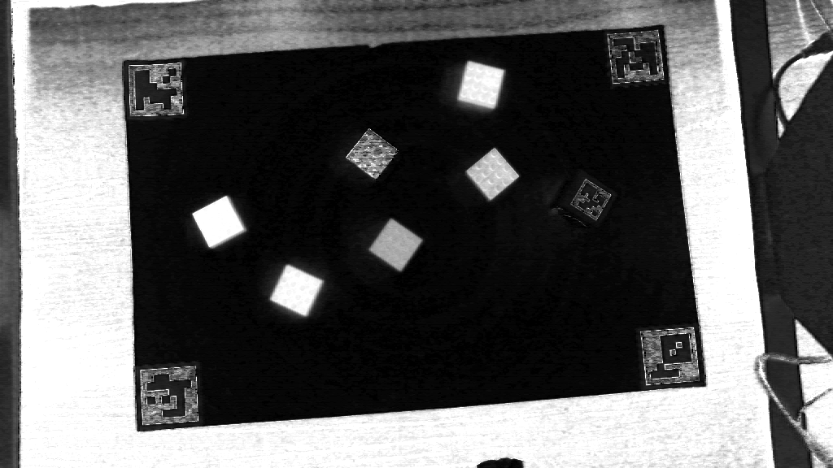
Obstacle Detection (Computer Vision)
Saturation Channel from HSV

Slide 13
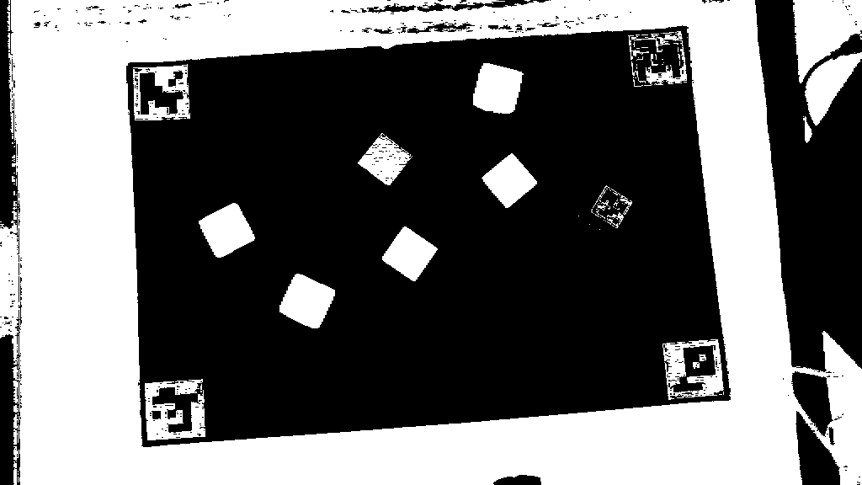
Obstacle Detection (Computer Vision)
Thresholding (outputs binary image)

Slide 14
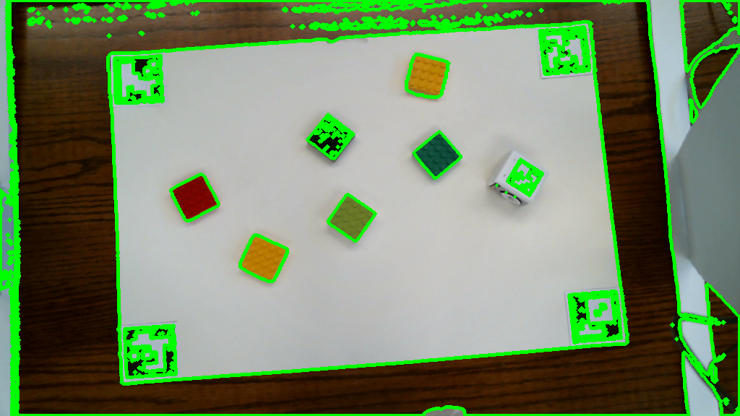
Obstacle Detection (Computer Vision)
Contour Detection (all possible contours)

Slide 15
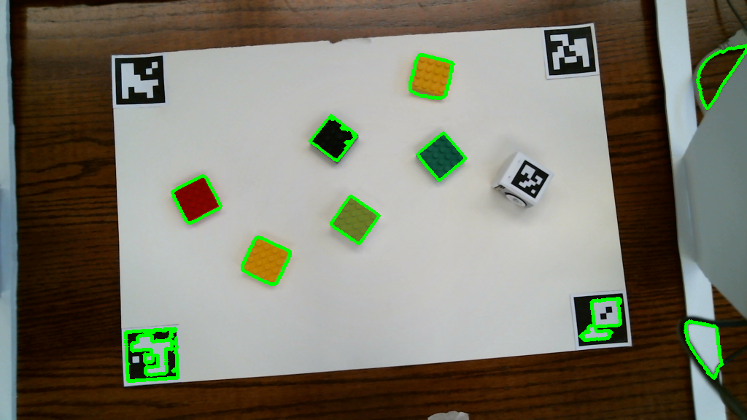
Obstacle Detection (Computer Vision)
Contour Size Filtering

Slide 16
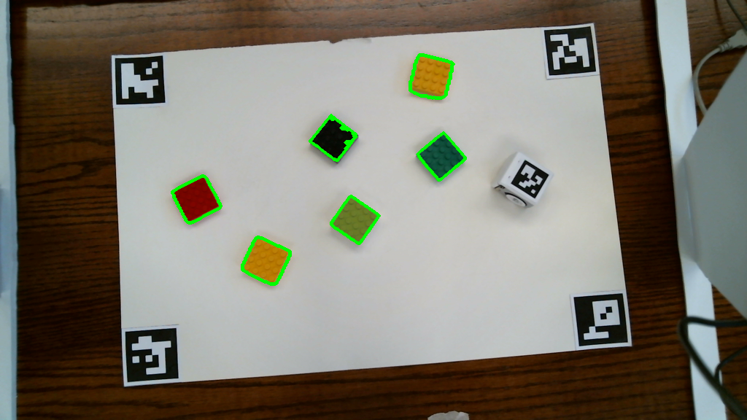
Obstacle Detection (Computer Vision)
Contour Solidity (Shape) Filtering

Slide 17
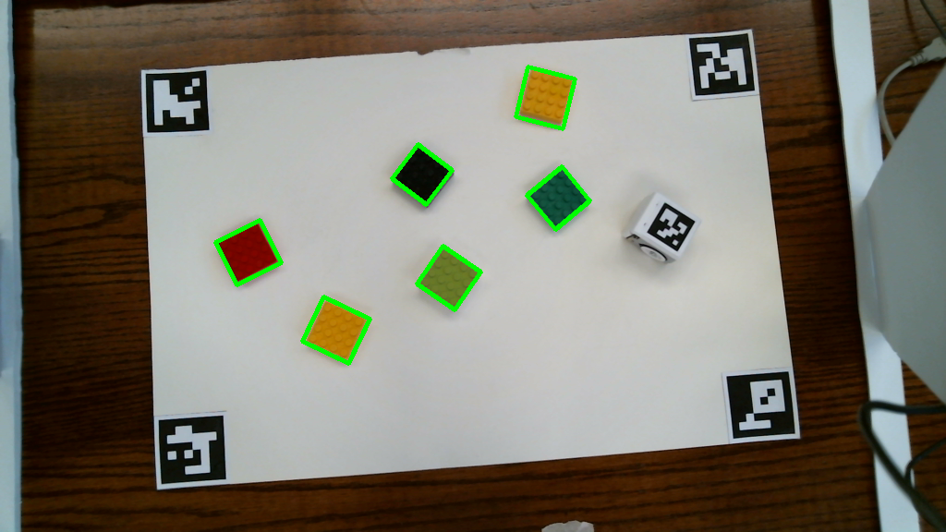
Obstacle Detection (Computer Vision)
Contour Simplification to Rectangle

Slide 18
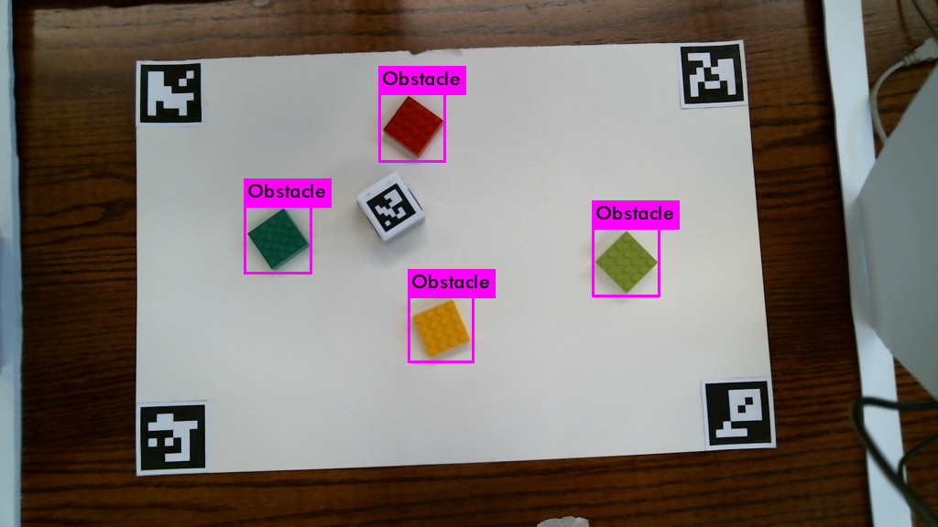
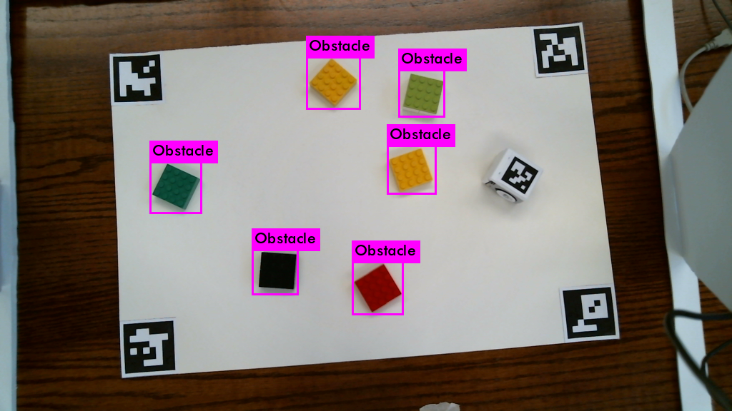
Neural Network Obstacle Detection
YOLO is a neural network architecture used for training object detection
Runs on an image and outputs a set of bounding boxes and probabilities for potential obstacles
Trained on a dataset of about 200 images with obstacles labelled with bounding boxes
Need to add masks or segmentation within bounding box for accurate obstacle shape

Slide 19
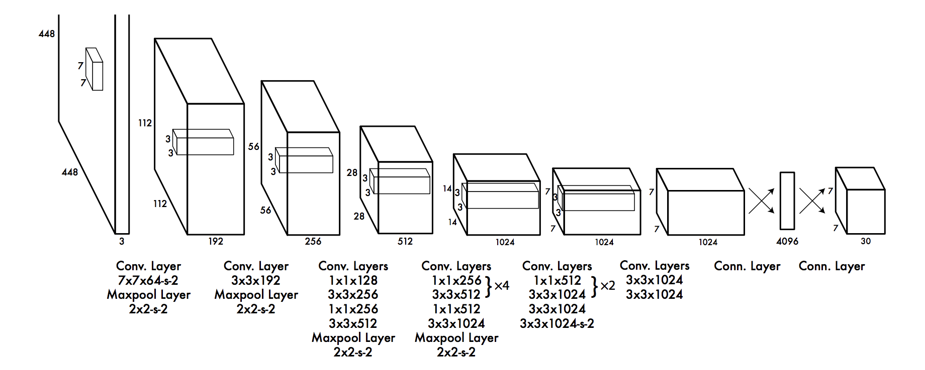
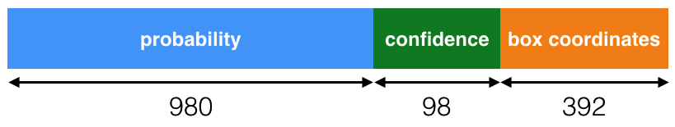
Neural Network Obstacle Detection
YOLO Network uses a series of 24 convolutional layers and 2 fully-connected layers

Slide 20
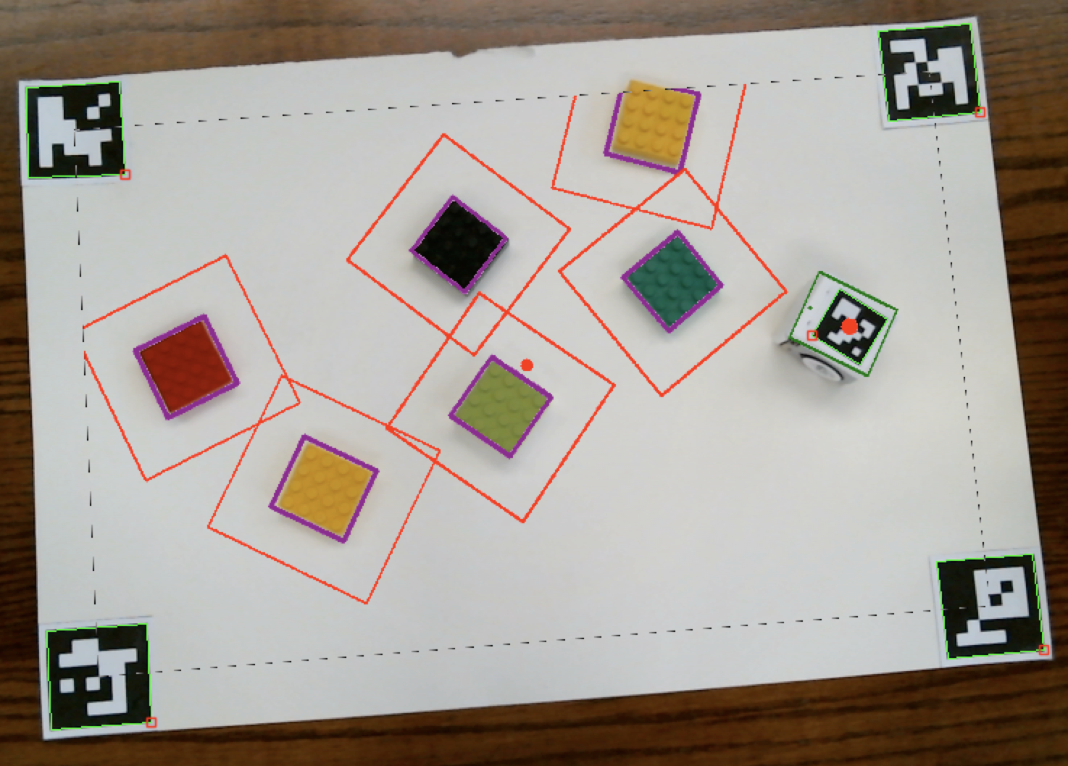
Configuration Space
Robot is modelled as its circumscribed circle to make the creation of the configuration space simpler
Configuration space is created by expanding each obstacle outward by increasing the length of the vector from the obstacle center to each corner.

Slide 21
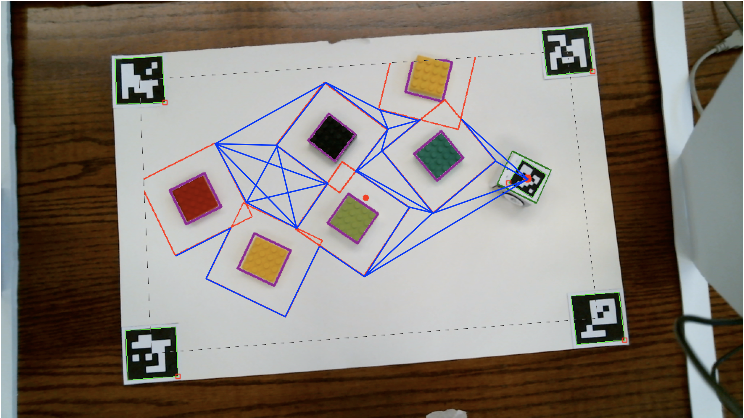
Roadmap Creation
Obstacles must be converted to nodes / edges for graph search algorithms (Dijkstra’s algorithm)
Visibility graph created by using obstacle corners as nodes
Straight lines connect nodes to other nodes which they can access

Slide 22
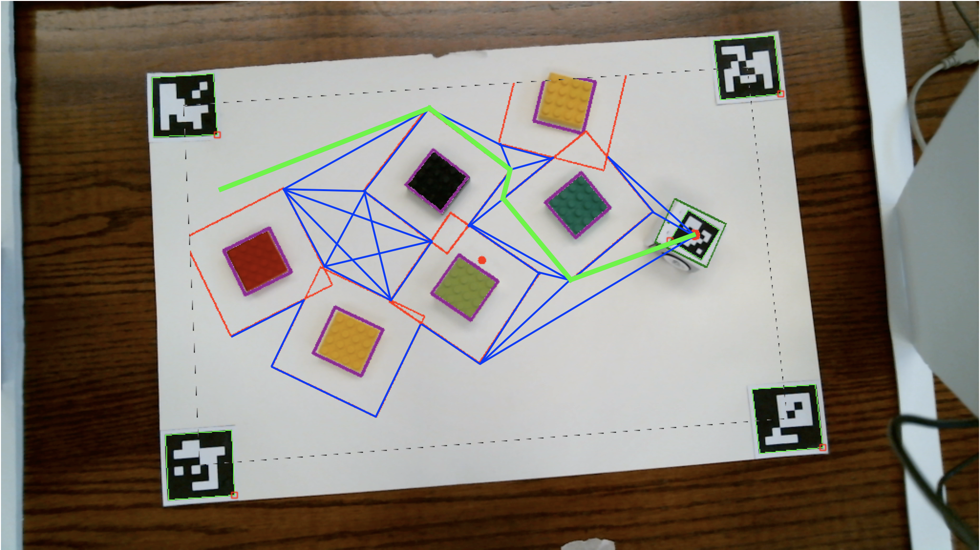
Path Generation
The optimal path is found using Dijkstra’s algorithm to traverse the (relatively small and simple) visibility graph and find the shortest path by from the start node to the end node.

Slide 23
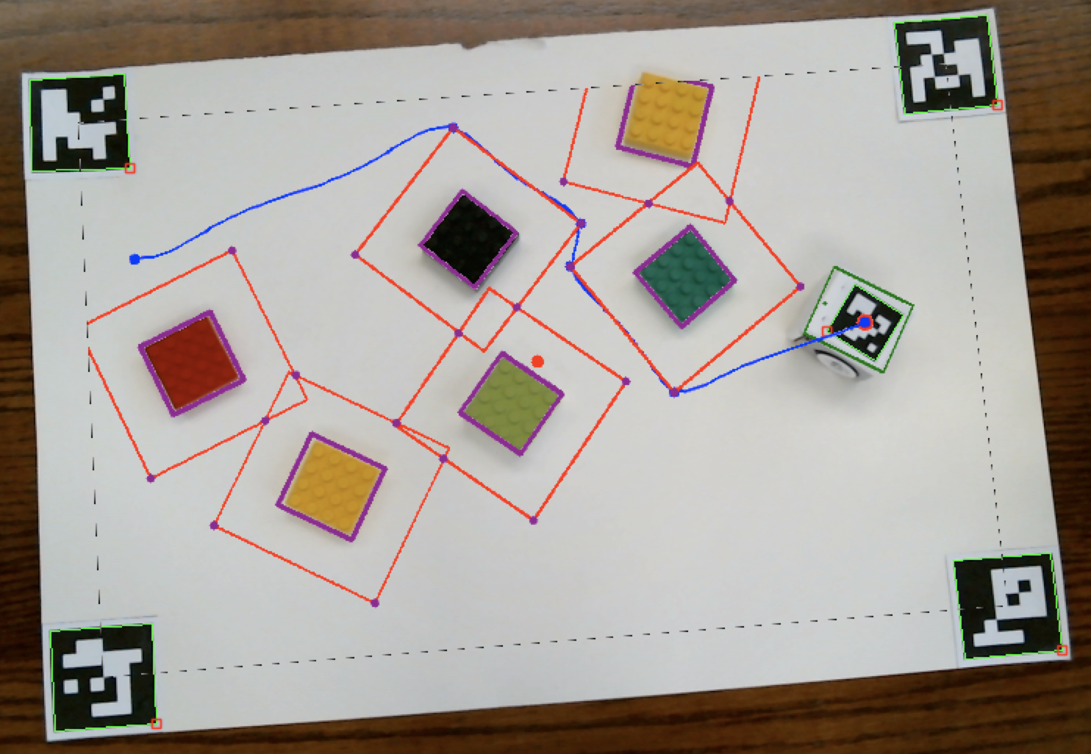
Path Smoothing
Visibility graph path often has sharp edges, which are tricky for the robot to handle
Solved by fitting B-Spline curves between the path points to smooth out the points and intersections.
Also creates a large number of points, which is necessary for pure pursuit to work.

Slide 24
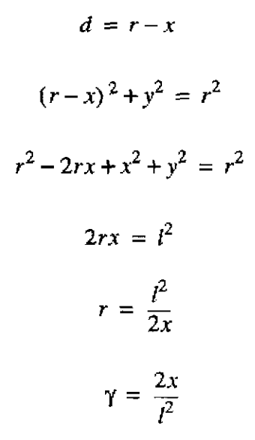
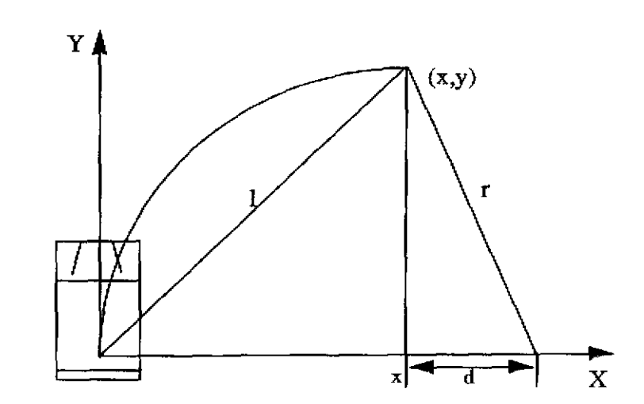
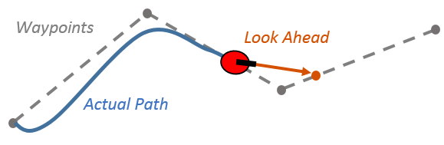
Path Following
Pure pursuit algorithm is used for path following
At every point, robot picks a lookahead point (certain distance ahead on the curve)
Create an arc from robot position to lookahead point and follow that arc (curvature + velocity -> left wheel + right wheel)
Allows smooth, constantly-correcting path following
Limited by robot’s dynamics, which is not an issue for the lightweight, rapidly-accelerating Hamster robot

Slide 25
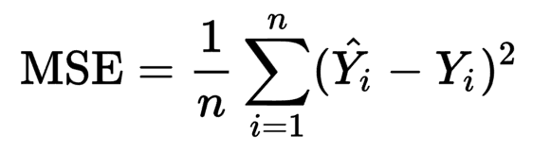
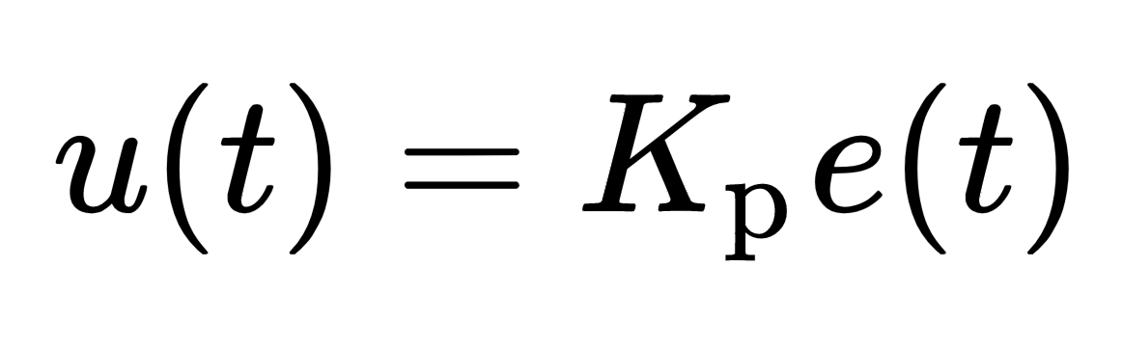
Automatic Replanning
Obstacle detection run repeatedly in its own thread
Detects obstacle changes by detecting high MSE between previous and current obstacles (or addition/removal of obstacles)
Path is reset and replanned when new obstacles detected
Path is reset and replanned from robot’s position if the path-following error (distance to lookahead) is very high
Proportional controller used to rotate robot to align with path at the beginning

Slide 26
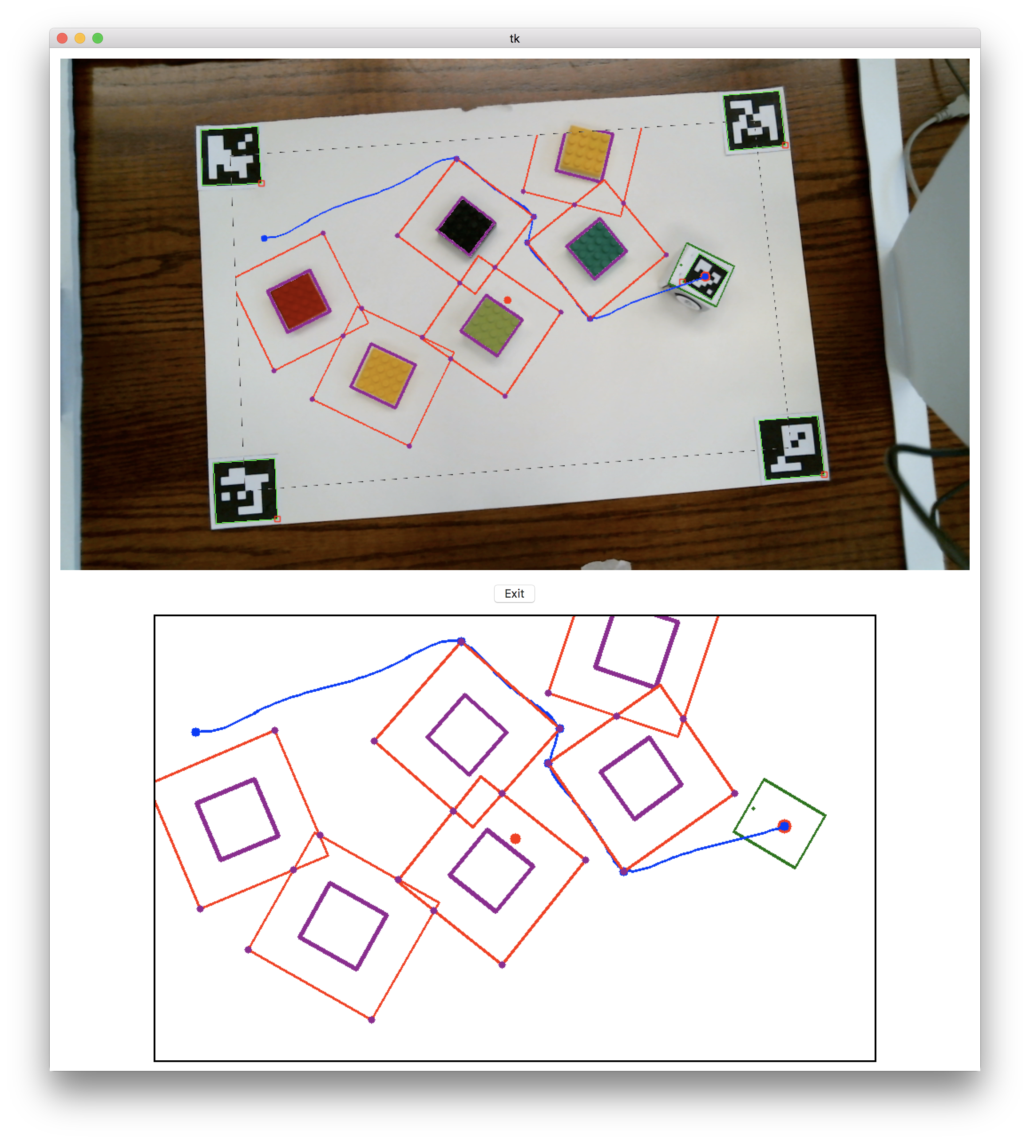
Rendering / UI
Simple Tkinter UI
Map (bottom half) rendered using OpenCV drawing points, lines, etc.
Perspective transform used to project onto the actual image (top half)
Click anywhere on map to set as new goal point

